Slide 1

6372 Unit 5 Pre Live Assignment
By-Rashmi Patel

Slide 2
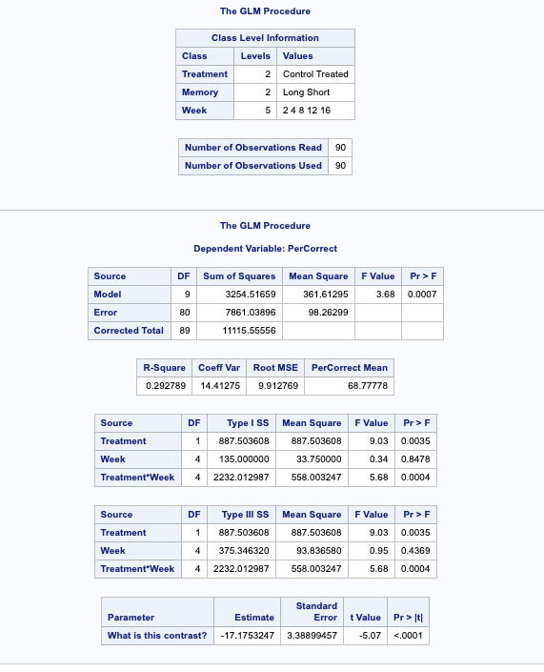
6372 Unit 5 Pre Live Assignment
Basic Two-Way ANOVA on monkey data

Slide 3
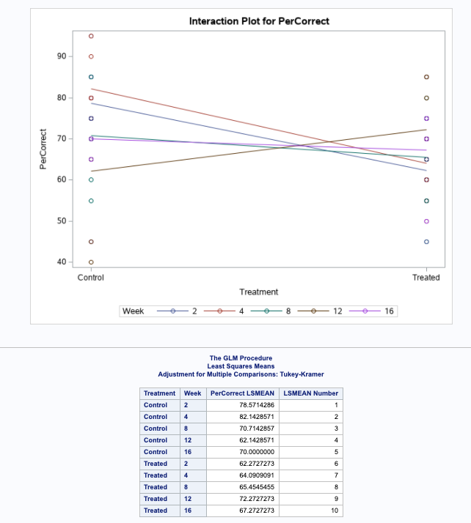
6372 Unit 5 Pre Live Assignment
Basic Two-Way ANOVA on monkey data

Slide 4
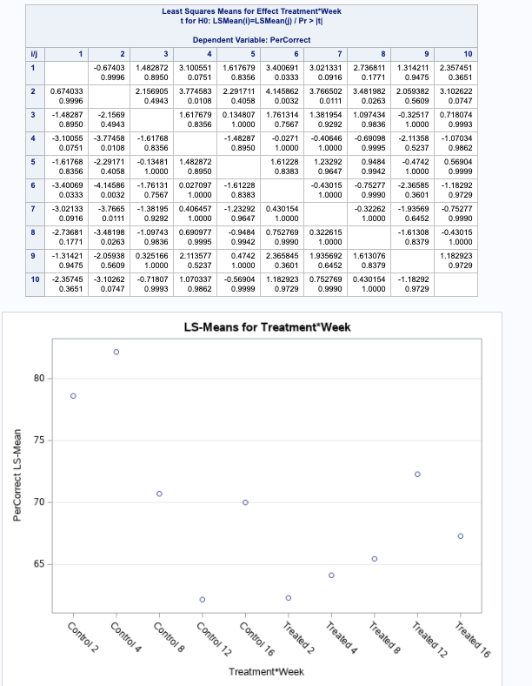
6372 Unit 5 Pre Live Assignment
Basic Two-Way ANOVA on monkey data

Slide 5
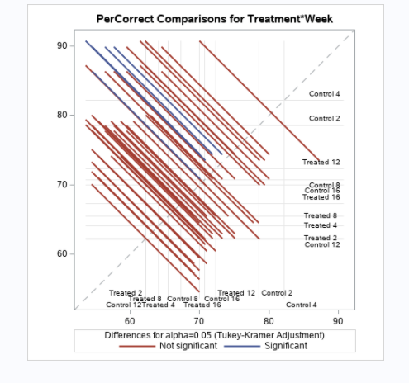
6372 Unit 5 Pre Live Assignment
Basic Two-Way ANOVA on monkey data

Slide 6
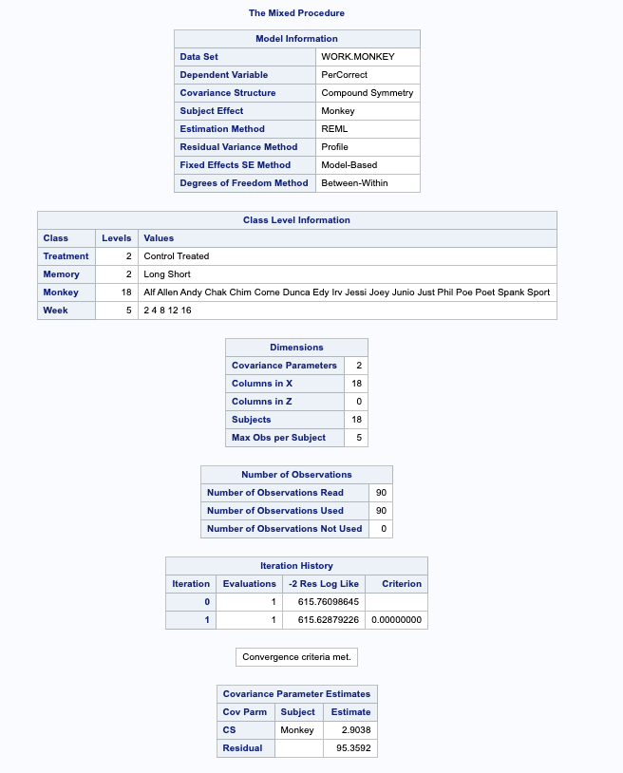
6372 Unit 5 Pre Live Assignment
Proc Mixed on monkey data

Slide 7
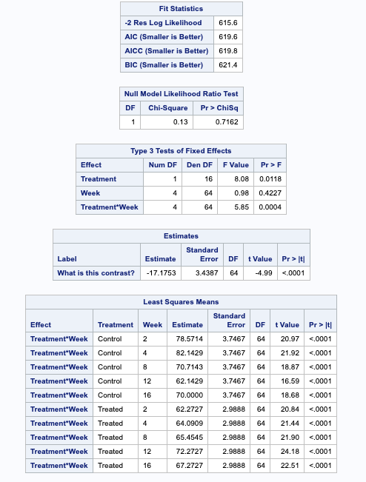
6372 Unit 5 Pre Live Assignment
Proc Mixed on monkey data

Slide 8
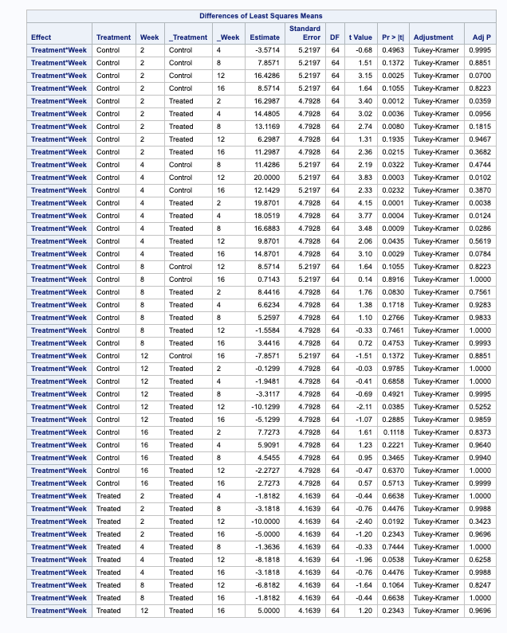
6372 Unit 5 Pre Live Assignment
Proc Mixed on monkey data

Slide 9
6372 Unit 5 Pre Live Assignment
Compare the type-3 sums of square ANOVA table (from the GLM model ) with that from the type3 table for fixed effects using the other model (repeated measures using PROC MIXED). What if anything has changed in terms of testing and the actual F values and pvalues?
In both ANOVA and mixed statement outputs, the week term as main term seems insignificant and Treatment and interaction term of Treatment* Week seems significant. There is not much difference seen in F-values values for both tables.

Slide 10
6372 Unit 5 Pre Live Assignment
Based on what you know about 2way anova, is there an interaction? Also, to get at one of the researchers questions, figure out the contrast that would test for the difference in mean percentage between Treated and Control groups specifically for Week2.
Yes, I think there is an interaction term Treatment*Week. I think the image below would test for the difference in mean percentage between Treated and Control groups specifically for Week2. The result of the test seems to be significant with p and adjusted p both being below 0.05.

Slide 11


6372 Unit 5 Pre Live Assignment
Can you also write a contrast to test for Week 12 vs Week2 for the Treated group? Include the contrast in both of the procs and compare the result. Are they the same, if not what is different?
I think below contrast shown test for Week 12 vs Week2 for the Treated group.
After including contrast in both procs, the results obtained are same with p-value very close to each other yielding insignificance in all 3 cases.

Slide 12
6372 Unit 5 Pre Live Assignment
I have added an additional contrast already in the code. Can you tell me what it is testing for? Hint: It is related to the key question discussed about this data set from the videos and the text.
The contrast given in the code tests for the treated group for week 2 and week 4. The estimates table shows p-value<0.0001 which seems significant for both procs.

